Slide 1
The Whartons Vision, Mission and Values
We pledge……

Slide 2
Our Vision- Excellence, Enjoyment and Achievement for All
Vision Statement- We believe that learning should be fun, purposeful, and challenging for all children.
We will achieve this by:
Equipping our children with a sense of well-being, empathy and belonging; through the wide range of learning experiences both within the school family and throughout our wider community
Celebrating difference and enjoying the rich environment that diversity brings
Nurturing and challenging all our children, meeting their individual needs thus enabling them to thrive and reach their true potential
Providing a curriculum which reflects children’s interests and engages children’s curiosity in the world around them; regularly using the outdoor environment to enhance learning experiences
Lay firm foundations for life-long learning through developing pupils’ skills of relationship building, resilience, risk-taking, resourcefulness and reflection (Learning to Learn)
Developing our children to be self-assured, independent thinkers with an enterprising spirit

Slide 3
Our Vision- Excellence, Enjoyment and Achievement for All
Mission Core Values
Working together Respect and Inclusion
Embracing challenge Responsibility and teamwork
Raising expectations Passion for learning
Creative learning Creativity and enterprise
Effective communication High expectations
Listening to others
Our Pledges-
Always Support for Others
Always respect each other and the environment
Always have high aspirations
Always reflect

Slide 4
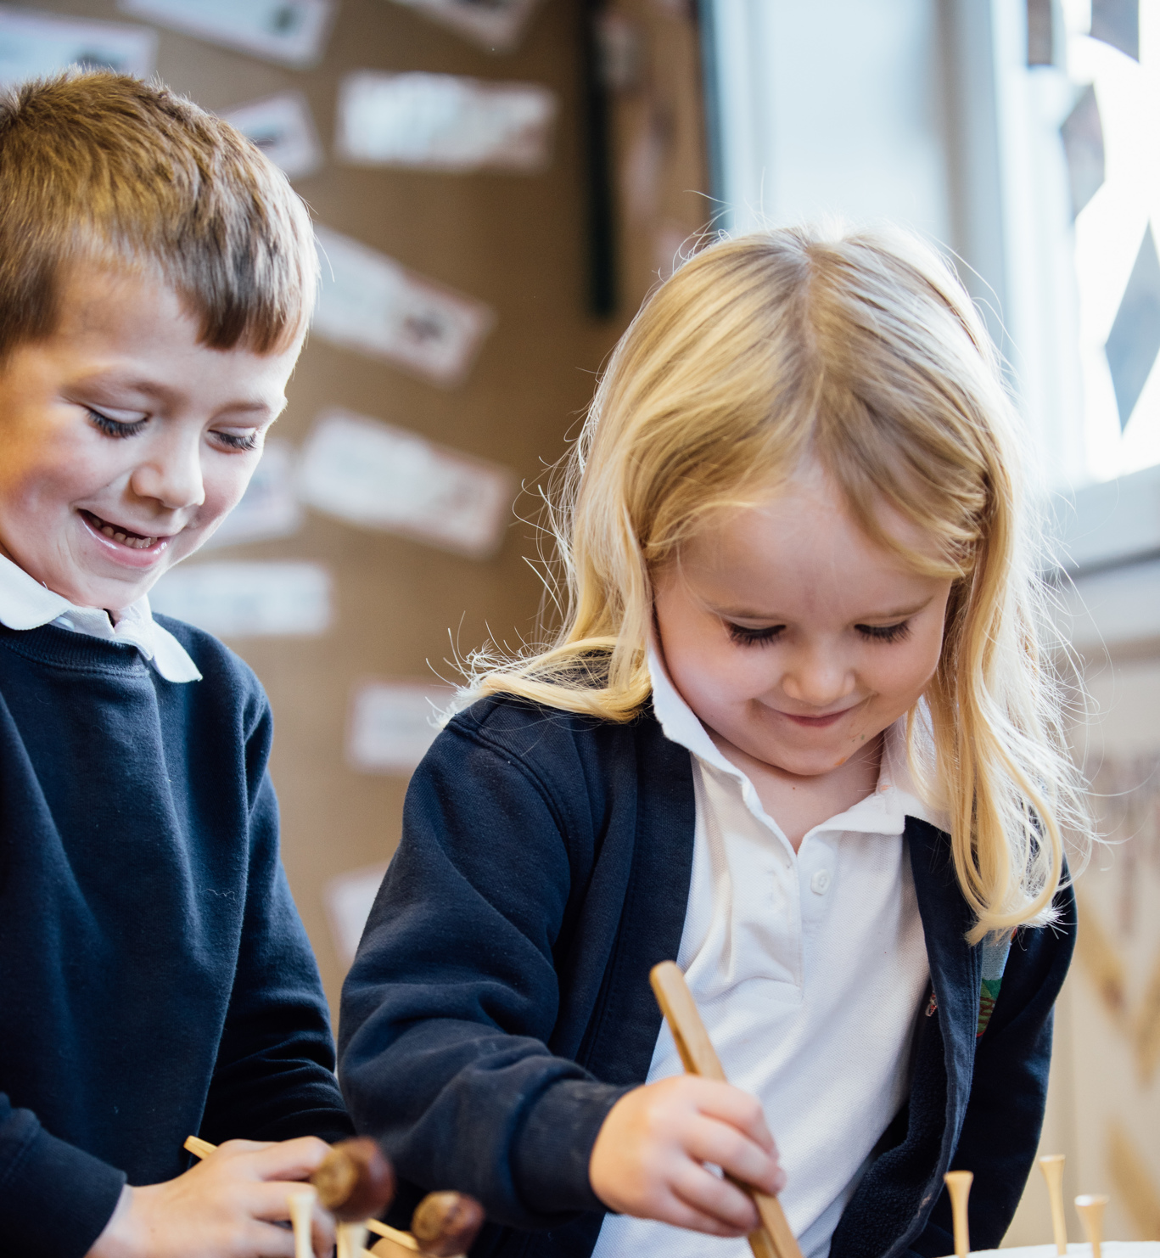
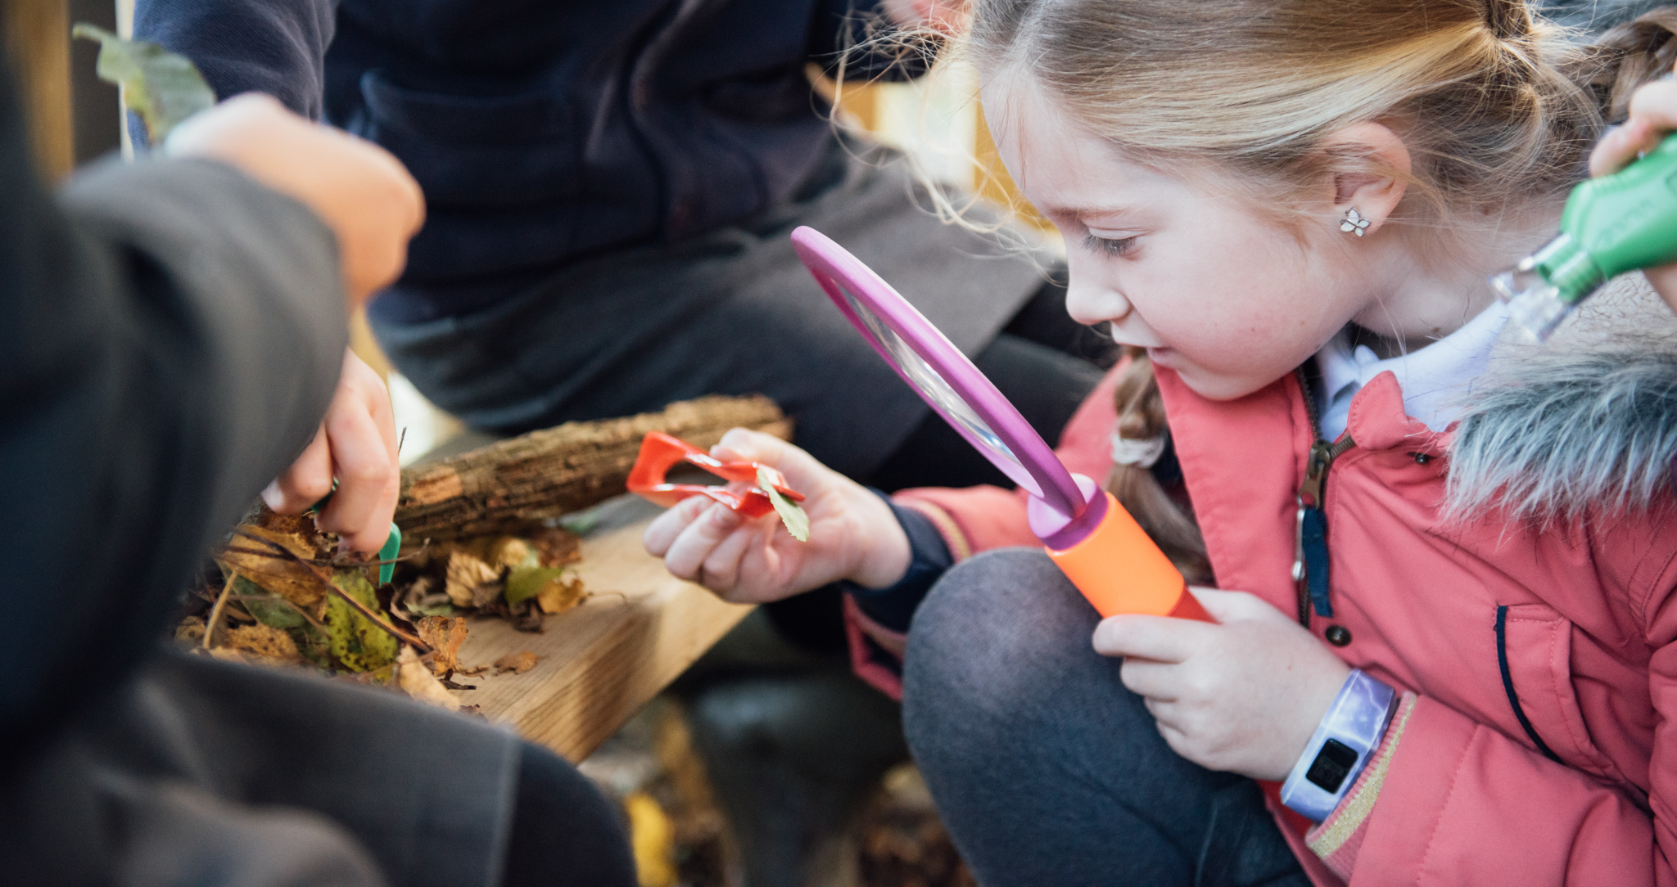
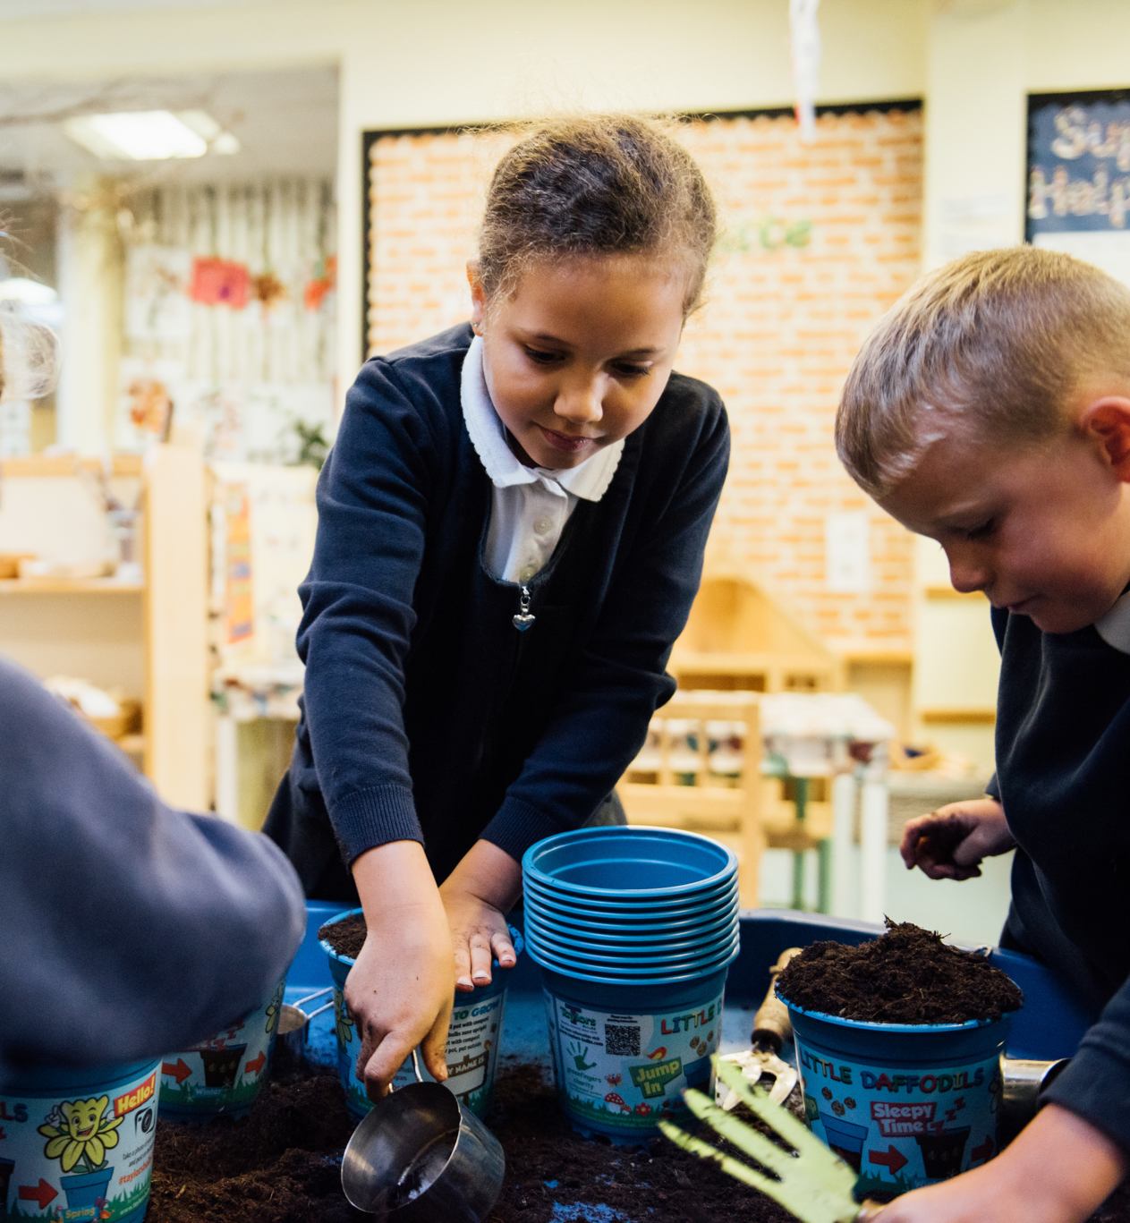
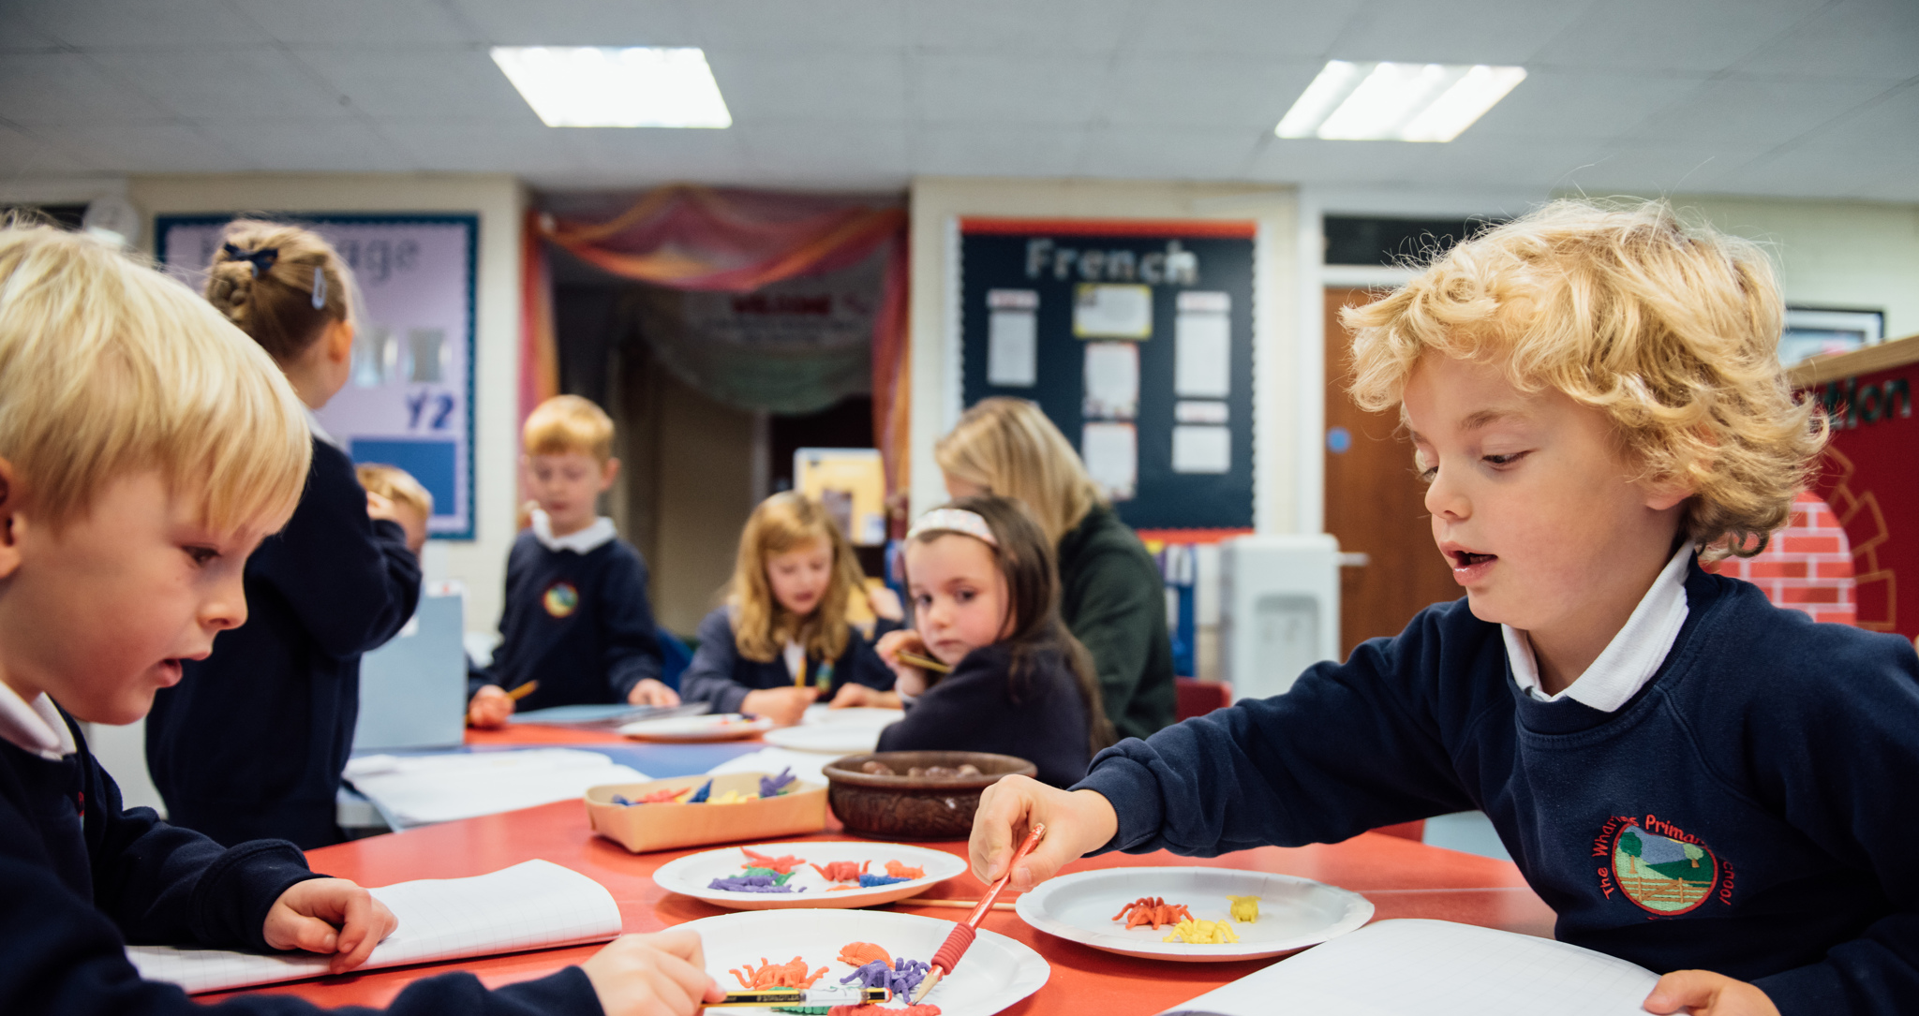
Our Vision and Mission in Action

