Slide 1
Parent Forum
29th September 2016

Slide 2
Progress Towards Ofsted Recommendations- The Journey
Improve consistency of good or better teaching across school
Raise expectations of all children’s learning behaviours and what they can achieve at each stage of development,
Teachers monitor the progress of all groups in their classes from starting points and eliminate gaps
Funds to support disadvantaged children have an impact on achievement.
Builds on successes and what children have already achieved
Check basic skills are secure and use them across other subjects
Challenge children in the EYFS in reading, writing and number skills
More effective assessment systems accurately define pupil progress and inform planning
Middle leaders contribute to improvements
Governors work with leaders to scrutinise information

Slide 3
Collaborative Working- Sharing Best Practice
Working alongside year group partners from Bramhope Primary school has ensured consistency in good teaching across school (T&L review)
Pupil premium spending review and action planning with colleagues from Stanningley Primary ensured spending was clearly focused on narrowing gaps
Joint cluster project ‘Building Resilience’ highlighted successful strategies such as:
The Whartons key worker initiative;
Randomised learning partners;
Designing classroom environments to support independence
New EYFS team worked with outstanding teaching school leader to:
Reorganise planning so that it is objective led;
Increase opportunities to write and practise number skills in provision areas
Incorporate extra challenge and expectations eg characteristics of effective learning

Slide 4
Raising Expectations
Introduction of book contracts
Developing Learning to Learn skills- sets the expectation of children’s behaviour and effort towards their work
Target Time focus groups and purple pen of progress
Skills learnt in maths and English are transferred to ‘World Book’ ie cross curricular work
Introduction of mastery questioning and planned opportunities for mastery to occur ‘yellow dot’
Identifying learning journey for units of work with ‘I can’ statements to share expectations with children

Slide 5
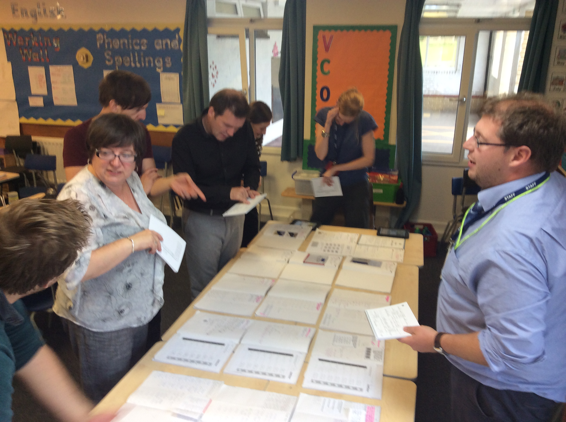
Monitoring Progress
Target tracker system- used by all teachers to track progress of all groups of children and identify next steps at half termly pupil progress meetings
Building expertise in identifying children’s attainment against new National Curriculum objectives through joint book scrutinies
Middle leaders working with school improvement team to identify opportunities which drive forward school improvements then analyse impacts by talking to children, observing learning and scrutinising outcomes.
Governors work with senior leaders in teams to evaluate the progress towards Ofsted criteria

Slide 6
Next Steps
All schools aspire to continual improvement
Commissioned an external Teaching and Learning Review to gauge impact of our initiatives
Focus this year on improving still further strategies to close the gap between pupil groups by:
Overhauling interventions,
Focus on pre/post learning and timely in class support
Building expertise in assessing and planning for age related expectations and mastery
alongside Oltey Family of Schools (Chevin Plan)

