Slide 1
The Whartons Primary Parent Forum
New Behaviour Policy and Procedures

Slide 2
Welcome
New Draft Behaviour Policy
Restorative Practice
Whole School Themes
Rewards and Sanctions
Learning Behaviours

Slide 3
New Behaviour Policy
Changes to practices but principles are the same:
Develop positive relationships which promote self-esteem, self-discipline, proper regard for authority and which establish clear expectations of all members of the school community.
Recognise the importance of effective teaching and learning in the promotion of positive behaviour.
Establish a partnership approach which draws on all those involved with the school.
Provide systems and structures which promote positive behaviour and which support all members of the school community.
Monitor and evaluate the effectiveness of our behaviour policy and procedures.
Working with experts
Complex Needs Team
STARS (Autism Team)
Restorative Practice
Orchard Centre
TaMHS, CAMHS
Notes:
Read out aims which are key to good behaviours
Talk about training and input from expert teams and incorporating those into the new policy to tweak existing practices for more effectiveness

Slide 4
Restorative Practice and Principles
Taking responsibility for actions and developing empathy.
Making amends, putting things right
Considering future actions and changes
Improving outcomes together
Notes:
Go through principles of restorative justice and training of staff
Check in for adults everyone has a voice

Slide 5
Restorative approach
What has happened?
What is the impact on
those involved?
What needs to happen
To put things right?
Notes:
establish a respectful rapport with people;
• listen and respond calmly, empathically and without interruption or judgment to all sides of an issue;
• inspire a sense of safety and trust;
• encourage people to express their thoughts, feelings and needs appropriately;
• appreciate the impact of people’s thoughts, feelings, beliefs and unmet needs on their behaviours;
2
• encourage those involved in the problem to find their own solutions.
• A one way conversation, with one person listening and asking questions and the other talking;
• A two-way conversation, with both people taking turns to ask and answer questions;
• A small meeting when one impartial person - a facilitator - poses questions to two people who have
had a difficulty, or where harm has been done, and who want to repair their relationship;
• A larger, facilitated meeting involving children, parents/carers, colleagues or others who have an
important role to play (sometimes called a ‘Restorative Conference’);
• A facilitated circle involving part or all of a class, a staff team or a group of residents.

Slide 6
Whole School Consistent Approach
Clear Golden Rules explored with the children
Rewarding children who follow the Golden Rules with Golden Time (photos and timetable of events)
New Going for Gold Approach (new traffic lights approach in classes, in the corridors and dining hall)
Assembly Themes and Certificates which follow SEAL themes of: New Beginnings, Getting on and Falling Out, Relationships, Say No to Bullying, Changes, Going for Goals and Good to Be Me
Clear Sanctions and Rewards matched to behaviours, displayed in classes (behaviour diamond) devised with children.
Behaviour Week

Slide 7
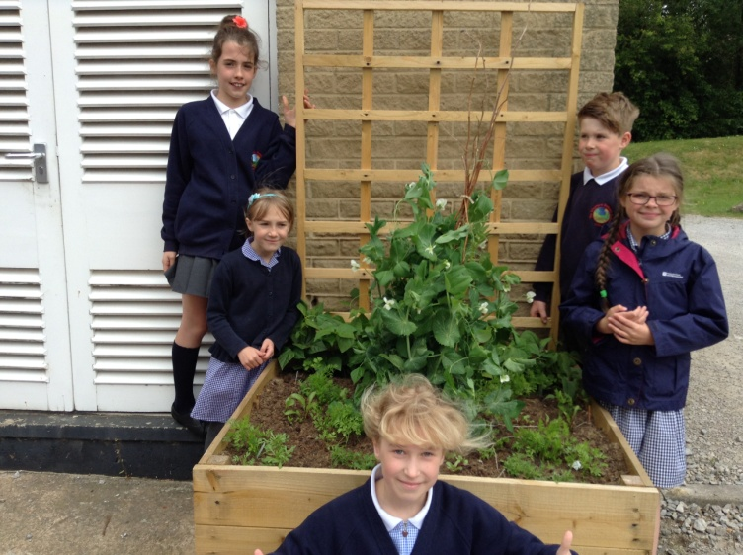
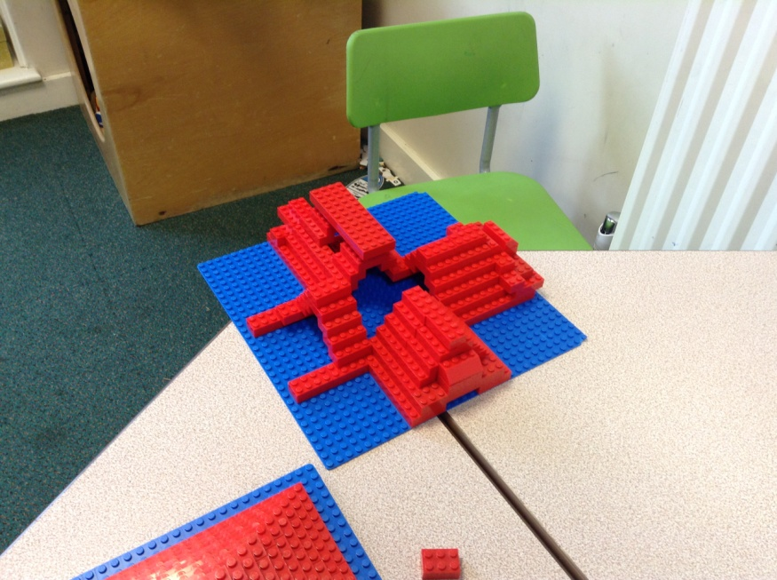
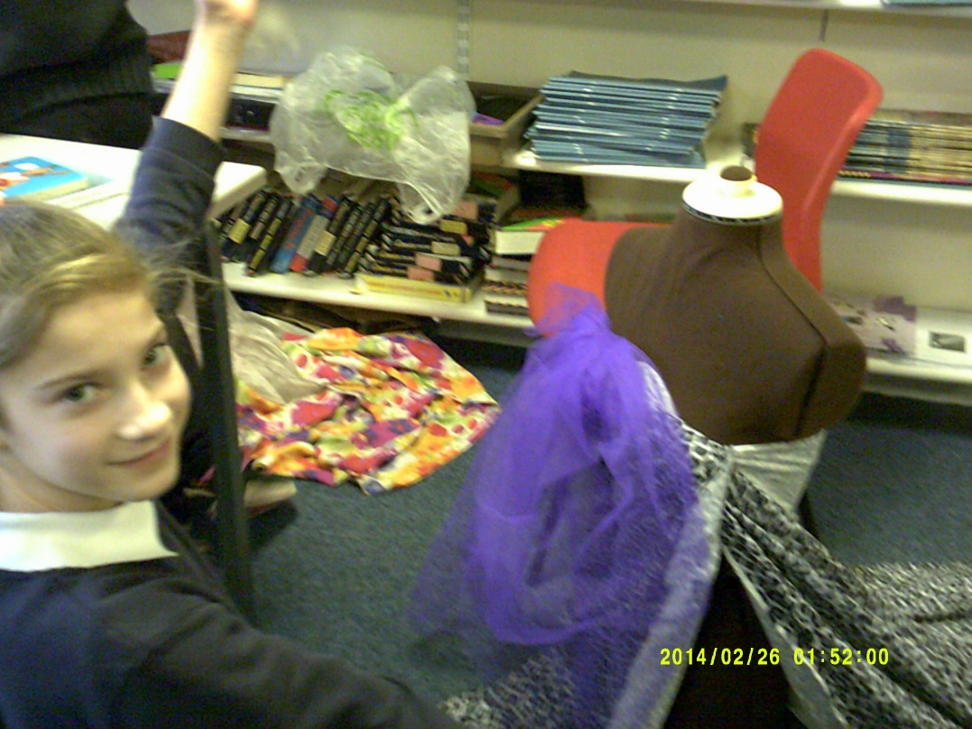
Golden Time Activities - Choices
Activity | Limits/KS | Room | Staff
Athletics | 30 | Outside | Mr Hampson
Patterns/Drawing Club | 30 | Yr 5 | Mrs Dowell
Carnival Club - making costumes/props etc | 30/KS2 only | Yr 2 | Mrs Dickson/Miss Donnelly
Drama | 15 | Yr 4 | Mrs Hawkins
Construction- Indoors and Out | 15 | Reception | Miss Wilkinson
Ipad | 30 | Yr 1 | Miss Stewart
Kareoke | 30 | Hall | Mr Williamson
Cricket | 30 | Field | Mr Young
Fashion - designing and creating fashion/outfits | 15 | Yr 6 | Mrs Kettleborough
Gardening Club | 20 | Grounds | Mrs Reynard/Mrs Bishop
Outdoor Club - exploring the grounds | 30 | Grounds | Mr Fisk

Slide 8
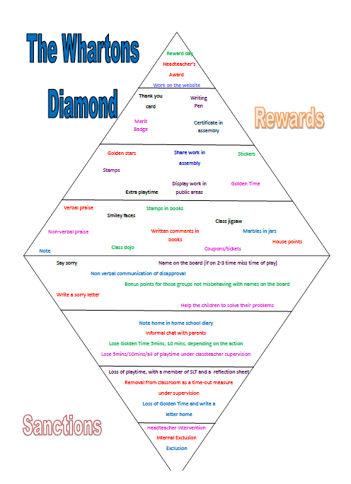
The Whartons’ Diamond

Slide 9
Learning Behaviours
The 5 Rs
Resilience
Resourcefulness
Relationships
Reflection
Risk Taking
Exploring the themes
A focus week for each skill
In class displays and time for children to consider which skills they need to use
Lessons focused to develop each of the skills
A new learning Journal for KS2 in the new year

Slide 10
The Journey and Impact
Incidents of unacceptable behaviour decreased from last year
Positive atmosphere in school with children taking responsibility for themselves, others and the school environment
Learning to learn skills are impacting on the development of children’s learning attitudes and behaviours, they are building an understanding of their part in learning

Slide 11
Any Questions?

