Slide 1
Year 6 – Red Kites
Reminder: bring your planner in everyday!
Homework
Please see below for what needs to be practised and completed daily at home (5-10 minutes each) throughout Year 6.
Maths & English CGP books
To support with the transition into secondary school, and the expectations of homework that come with this, we will set pages of work to be completed from each book every week.
I will try to tie the pages to what we are doing as class as much as possible.
If you come across any difficulties, please speak to me so we can solve it together.
This homework will start mid-way through Autumn term.
Maths & English CGP books
Reading
Reading
Make sure that you are filling in your reading record at least 3 times a week.
This is your job, not your parents’.
I am asking you what you think of the book you are reading, e.g. I thought this part was exciting, because when the flood came, all the dragons had to cling on to the roots of the trees.
And which new words you have found – ask your parents, use a dictionary, look online, ask me (Mr W).
Maths: Key Instant Recall Facts (KIRFs)
Homework related to our KIRFs will be set on Mondays, to be completed and handed in the following Monday.
Please see next slide for our ‘Cheat Sheets’ to help you if needed.
Maths: Key Instant Recall Facts (KIRFs)

Slide 2

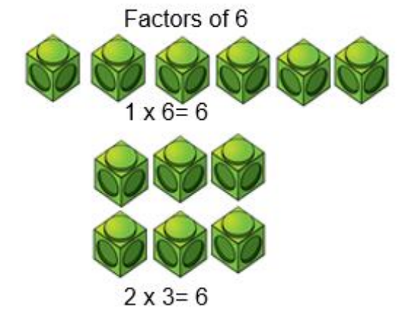
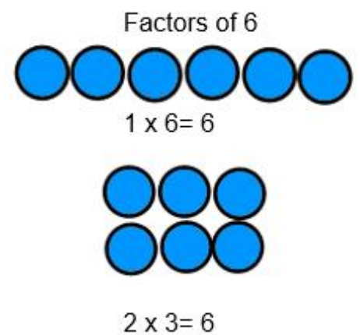
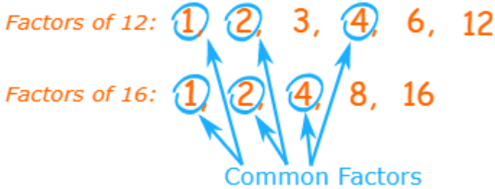
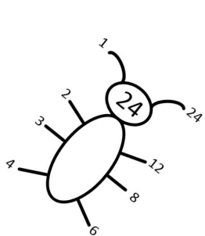
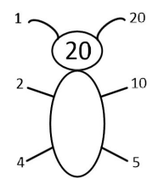
Y6 KIRF: I can identify common factors of a pair of numbers.
What can this look like?
Concrete | Pictorial |  | Abstract
Questions to ask at home What are the common factors of 18 and 21? Is 12 a common factor of 48 and 36? What is the highest common factor of 12 and 24? |  | Things to try Factor bugs – Each leg (or tail) is a factor of the bug’s number. Websites: https://www.topmarks.co.uk/maths-games/multiples-and-factors https://www.mathnook.com/math/math-speed-racing-factors.html https://www.math-play.com/Factors-Millionaire/factors-millionaire-game_html5.html https://vimeo.com/731425668
Key vocabulary Factor – A number that divides from a given number without a remainder e.g., factors of 12 include 6 and 2 because 12 ÷ 2 = 6 or 6 x 2 = 12 Multiple – A number that forms part of a specific group of multiplication e.g., multiples of 5 include 15, 20 and 25 Common factor – A number that divides into two different given numbers without a remainder e.g., A common factor of 18 and 12 is 6 as they both divide by 6
The common factors of 20 and 24 are 1, 2, 4

Slide 3
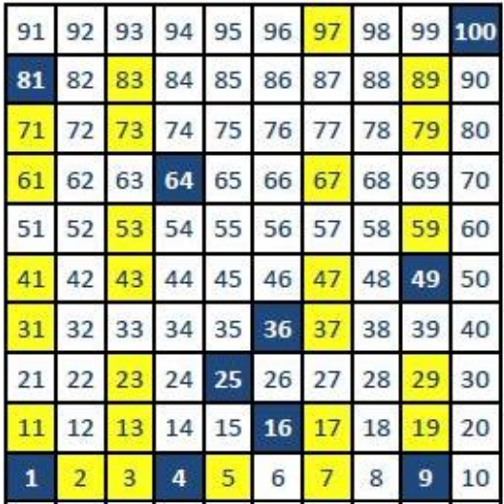
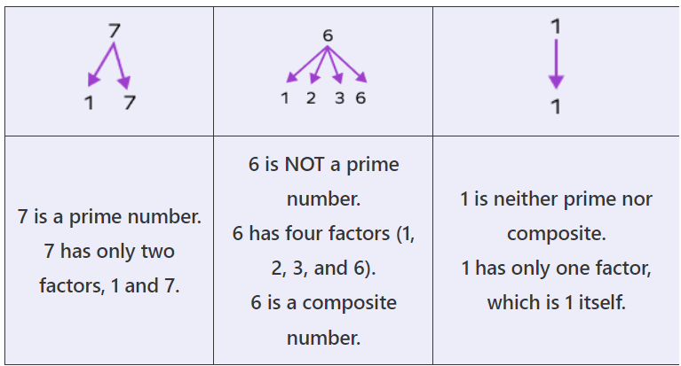
Y6 KIRF: I can identify prime numbers up to 100.
Key information
 | Find out if a number is prime is by trying and divide that number by all the numbers that are smaller. If it can only be divided by 1 and itself then it is a prime number. 1 and 0 aren’t prime numbers because you cannot divide 0 by anything and 1 can only be divided by itself. 2 is the only even prime number. Not counting 2 and 5, all prime numbers end in 1, 3, 7, 9. But, not all numbers ending in 1, 3, 7 or 9 are prime numbers. Prime numbers go on forever. They are infinite.
Key vocabulary Prime - Prime numbers are numbers greater than 1 that only have two factors, 1 and the number itself. This means that a prime number is only divisible by 1 and itself. Integers – whole numbers Composite – whole numbers which are not prime. Numbers that have more than 2 factors (but finite number of factors) are known as composite numbers. | Things to try Regular interaction with facts helps to move them from our short to long-term memory, therefore little and often is the best approach for revision. Choosing a random 2-digit number and checking if it is prime or composite will not take long, but is excellent practise. This KIRF is much easier once times tables are secured. Having Ultimate Recall will mean that square numbers are cracked and primes can easily be checked. Websites: Hit the Button ( https://www.topmarks.co.uk/maths-games/hit-the-button ) Prime Number Ninja Game (Number Ninja - Prime Numbers • ABCya! )
Our knowledge of factors is essential to learning prime numbers For example…
Prime Numbers – Numbers that are only divisible by 1 and themselves
(e.g. 3 x 1 = 3)
Square Numbers – The answer to a number multiplied by itself
(e.g. 6 x 6 = 36)

Slide 4
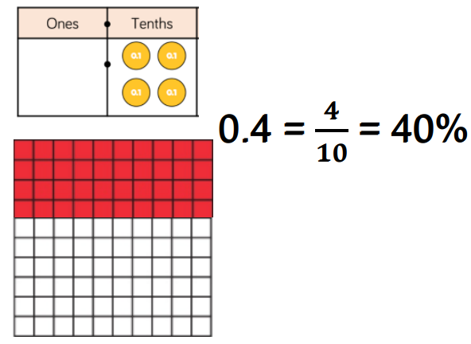
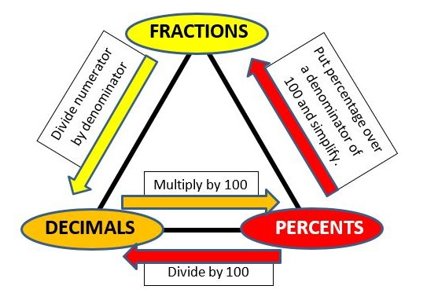
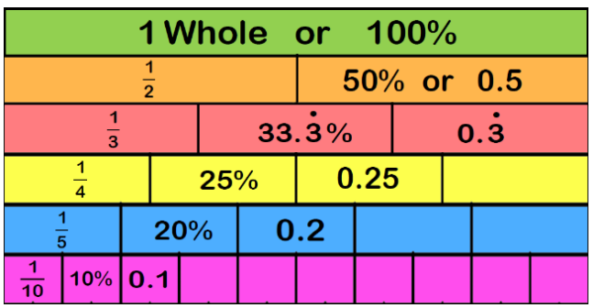
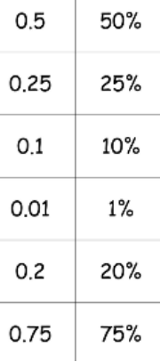
Y6 KIRF: I can convert between decimals, fractions and percentages.
What can this look like?
Concrete | Pictorial |  | Abstract
Questions to ask at home What is 15% as a fraction and decimal? Which is closer to 100%, 45 or 0.5? How do you know? Complete the sentence - to convert a decimal to a percentage you … |  | Things to try Dominos - write the fraction, decimal and percentage the domino is showing Pairs game- make your own fraction, decimal, percentage card matching game FDP Poster - create a poster which explains how to convert between fractions, decimals and percentages Let’s go shopping - look out for percentages when out shopping. What is 25% as a decimal? Websites: https://www.mathplayground.com/percent04.html https://mathsframe.co.uk/en/resources/resource/120/match_fractions_decimals_and_per centages#.UCdcd2MsCEY
Key vocabulary Convert – To change the expression without changing the size or amount Decimal number – A decimal is a way of writing a number that is not whole, and are used to represent a whole number plus a fraction of a whole number e.g., 4.2 means 4 and 2 tenths. 4.20 means 4 and 2 tenths and 0 one-hundredths. The last zero does not need to be there. 4.02 means 4 and 0 tenths and 2 one-hundredths. Fraction – A fraction represents the equal parts of the whole Per cent – Parts per 100. It shows the ratio ‘out of 100’

Slide 5
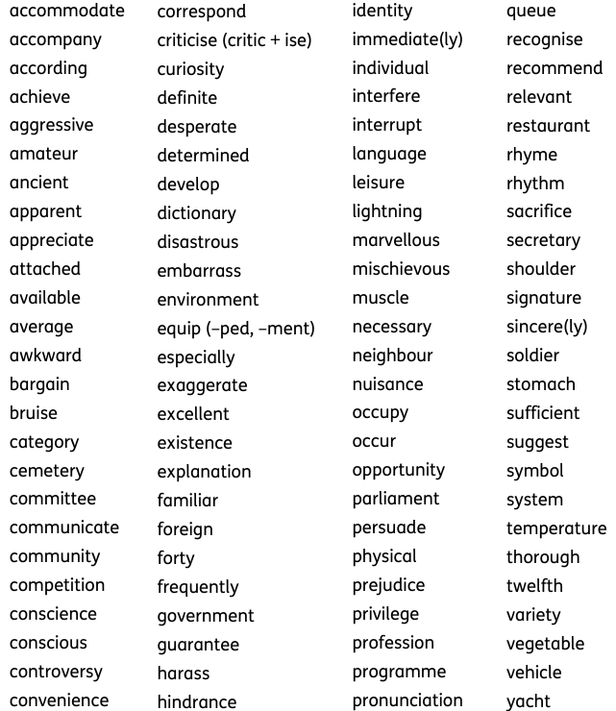
Spellings
(keep practising the Year 3&4 ones if you need to)
Each week, we are going to focus on words that fit the spelling patterns we’re doing in class, any ones we are repeatedly getting incorrect in our writing, and spellings from the statutory spelling list.
The best way to learn them is to focus on around five spellings and practise those, then when you have got those add in a couple more. When you have got those as well, stop doing the original five and add in a couple more and keep going like that. But, every week or so test yourself on the previous ones – can you still remember them? If you can, carry on; if not just pop them back in again.
We will test them in school, not to get a score, but just to help us find out which ones we’ve got (we’ll pink those in your home learning book) and which ones we need to keep. Aim to get through the full list over the Autumn and Spring term and then spend the summer term consolidating.
Spelling word list for Year 5 and Year 6

