Slide 1
Great Tower
Monday 18th May – Friday 22nd May 2026

Slide 2
Monday
Arrive at normal time!
Office and Hall
Money and Medicine
Saying goodbye

Slide 3
Staff
Roles and Responsibilities
Mr P Hampson
Party leader. Trip organisation. Group leader. First aid. Room Inspection. Evening Security check
Administration of medications. Collection of medication
Mr J Williamson (Monday, Tuesday, Wednesday) – Mr D Fisk (Thursday, Friday)
Group leader. Room inspections. Evening Security check. Pastoral care.
Mrs S Wilmot
Group Leader. Room inspections. Evening Security check. Pastoral care. First aid.
Miss S Smith
Group Leader. Room inspections. Evening Security check. Pastoral care. First aid.

Slide 4
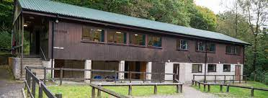

Slide 5
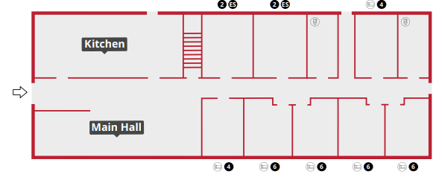

Slide 6
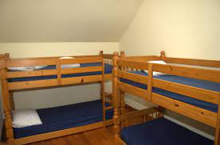

Slide 7
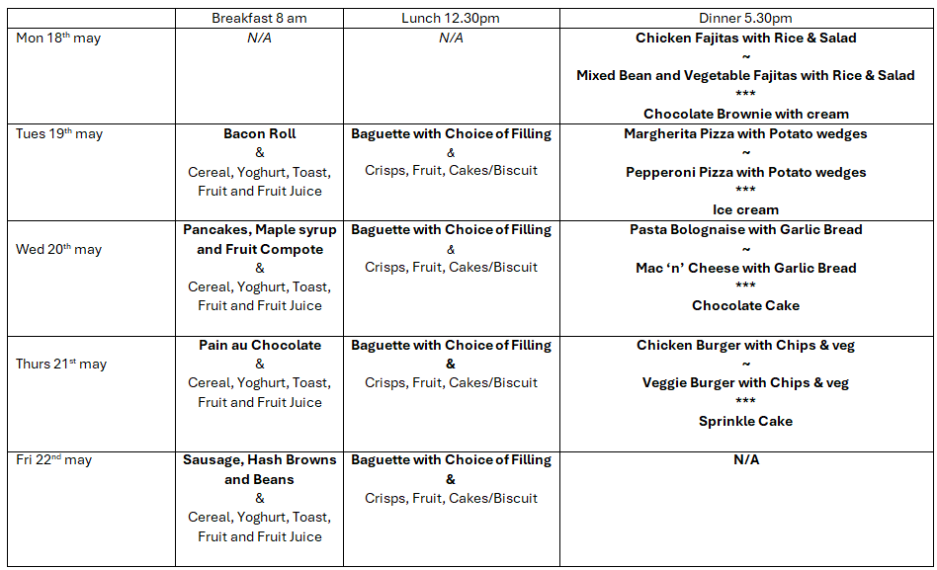

Slide 8
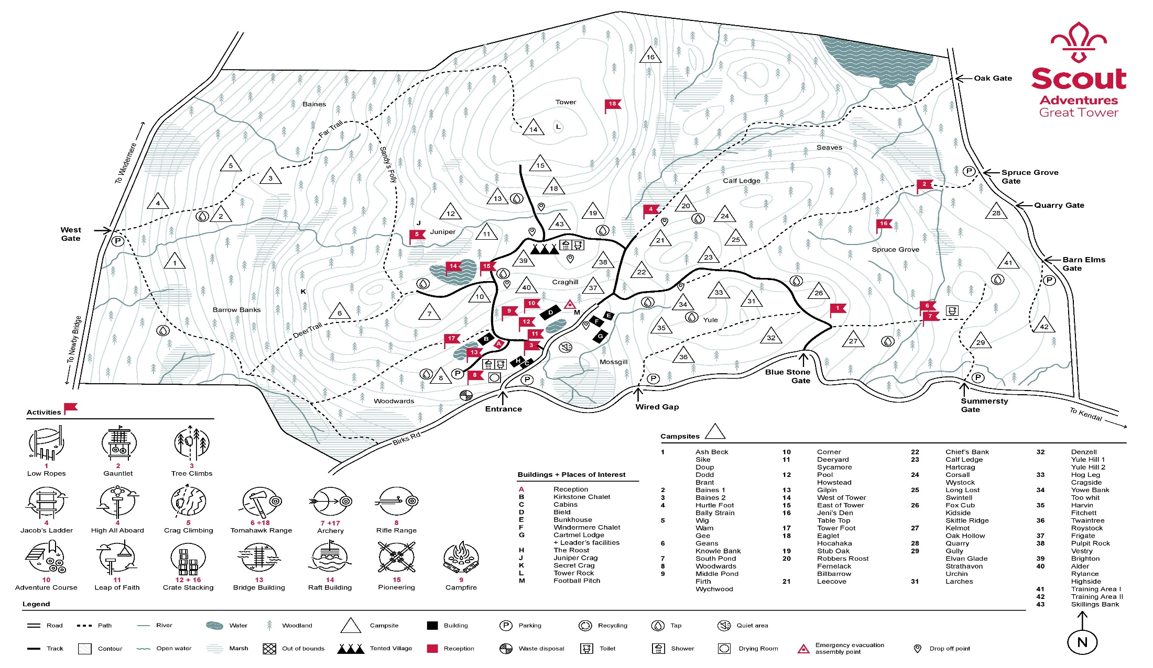

Slide 9
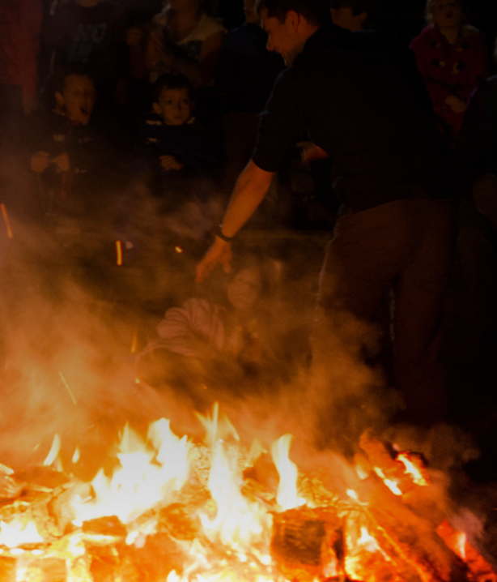
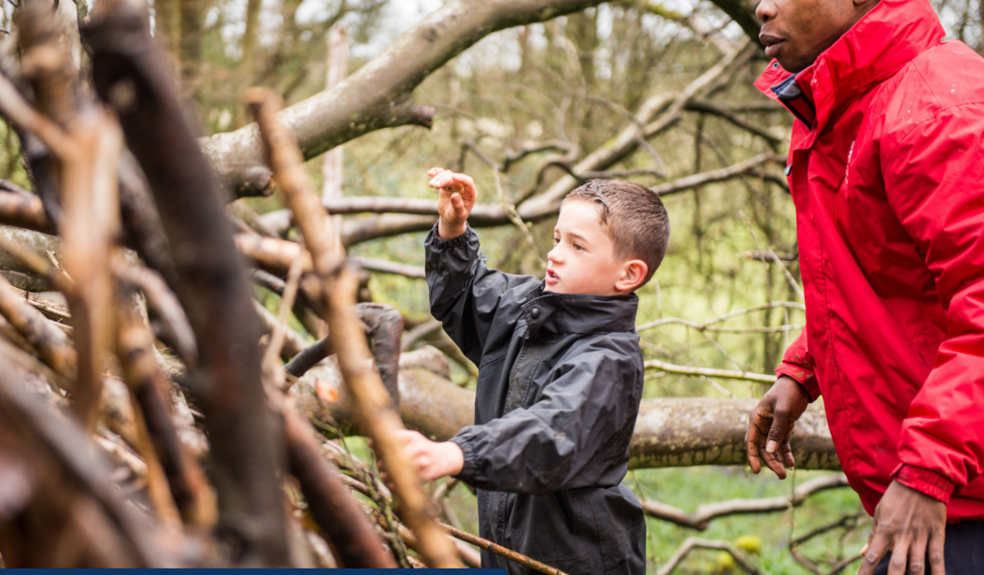
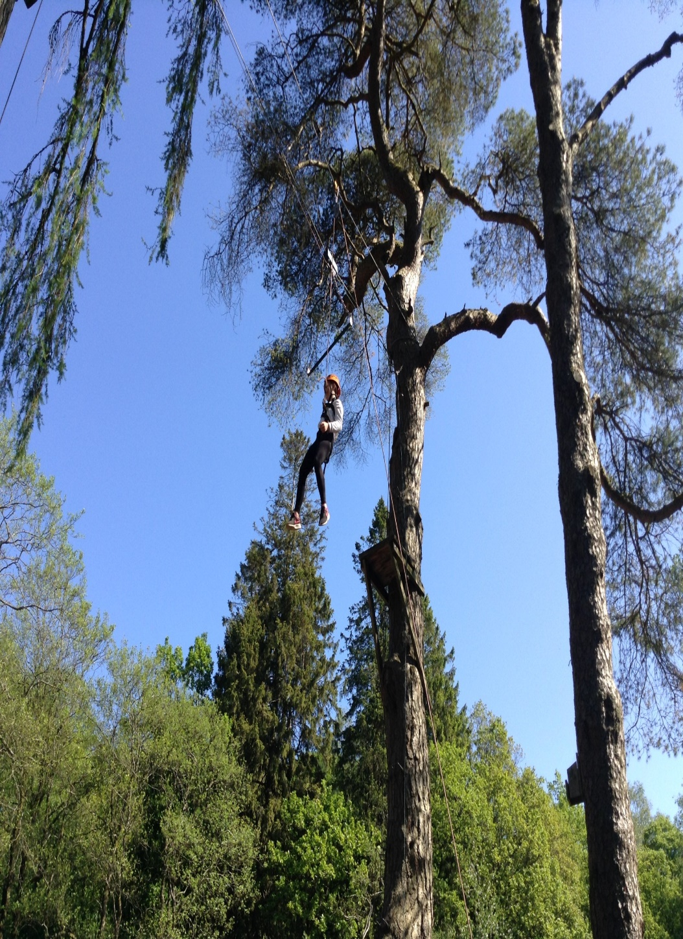
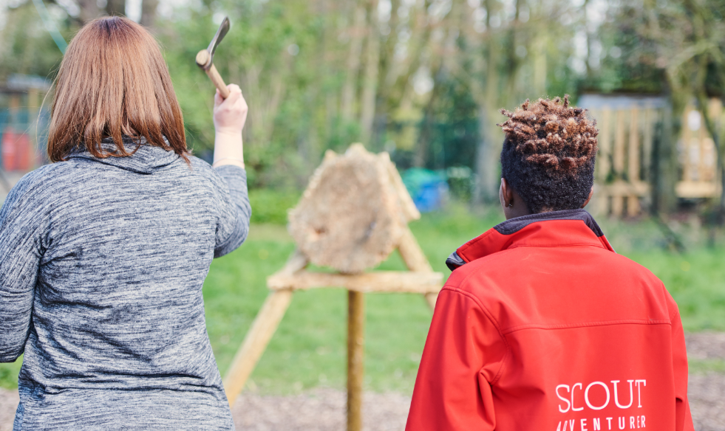
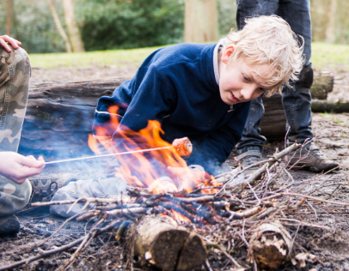
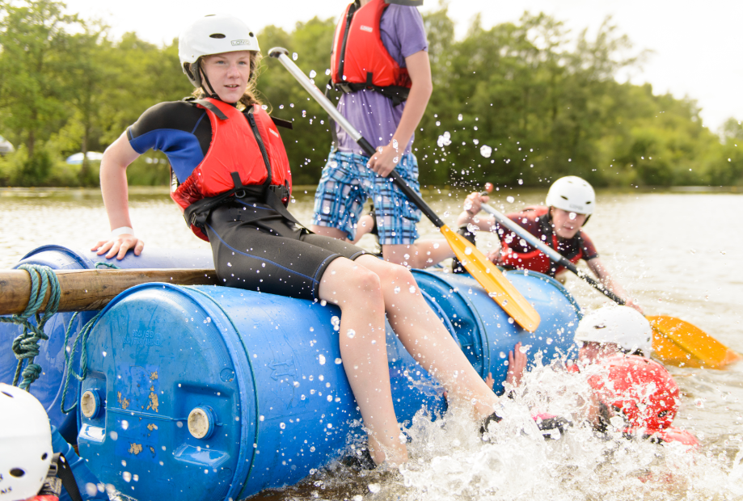
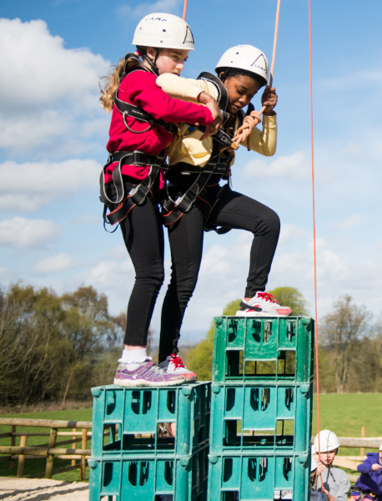
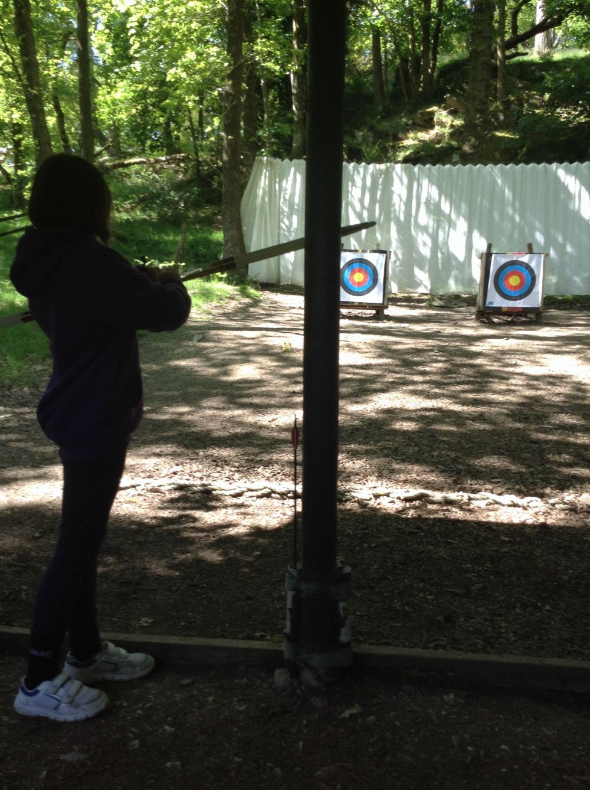
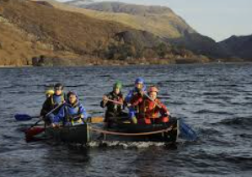

Slide 10


Raft Building
Campfire
Archery
Backwoods Cooking
Orienteering
Rafted Canoeing
Leap of Faith
Tomahawk Throwing
Shelter Building
Crate Stacking

Slide 11
Clothing, Equipment, and Personal Responsibility
Appropriate Outdoor Clothing
  Suitable clothing for all weather, including warm layers, waterproofs, and sturdy footwear, is essential for safety and comfort.
Clear Labelling of Items
  All clothing and equipment should be clearly labelled to prevent loss or confusion during outdoor activities.
Promoting Independence
  Pupils are encouraged to carry their own luggage to foster responsibility and independence during trips.
Staff Support and Guidance
  Staff provide guidance on packing and support in managing belongings, while encouraging pupils to take ownership.
Notes:
Appropriate clothing and equipment are essential for pupils to fully participate in outdoor activities. Parents are asked to provide suitable outdoor clothing for all weather conditions, including warm layers, waterproofs, and sturdy footwear. All items must be clearly labelled to avoid loss or confusion. Pupils should be able to carry their own luggage, promoting independence and responsibility. Guidance is provided on what to pack to ensure pupils are prepared without bringing unnecessary items. Staff will support pupils in managing their belongings, but children are encouraged to take ownership of their equipment. Being well prepared helps pupils feel comfortable, confident, and ready to engage in all aspects of the residential experience.

Slide 12
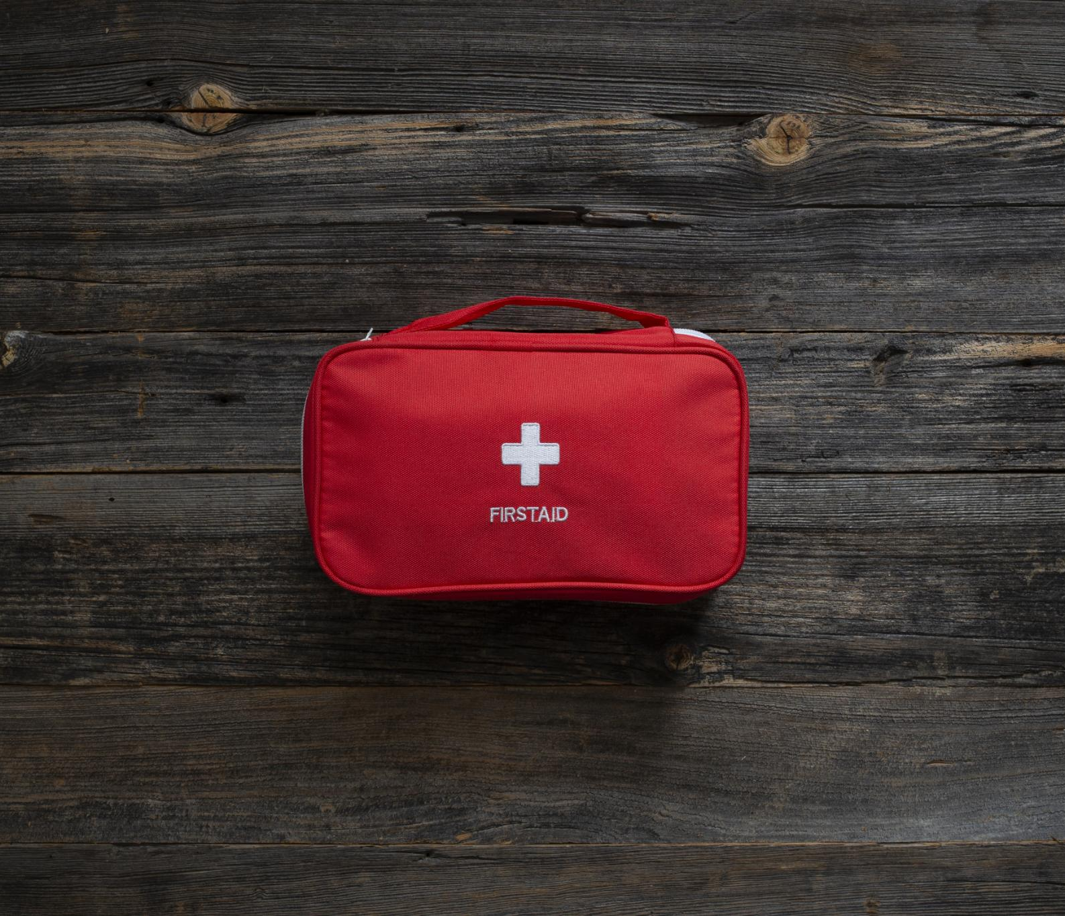
Medical Information and First Aid Provision
Accurate Medical Information
  Parents must complete medical forms accurately and update the school on health changes before departure.
Medication Management
  All medication should be clearly labelled and handed to staff for safe storage and administration.
Trained First Aid Staff
  Several staff members are trained as First Aiders to respond promptly to minor injuries and medical concerns.
Access to Further Medical Support
  Established procedures ensure quick access to advanced medical support for serious health issues.
Notes:
Accurate medical information is vital to ensuring pupil safety during the residential visit. Parents and carers must complete all medical forms carefully and inform the school of any changes prior to departure. All medication must be clearly labelled and handed to staff, who will store and administer it according to agreed procedures. Several members of staff are trained First Aiders, ensuring prompt and appropriate responses to minor injuries or medical concerns. For more serious issues, established procedures are in place to access further medical support. This structured approach ensures that pupils’ health needs are managed safely and sensitively throughout the visit.

Slide 13
Pocket Money, Valuables, and Personal Items
Pocket Money Guidelines
Pupils can bring up to £10 in £1 coins for souvenirs, handed to staff for safekeeping and controlled distribution.
Restrictions on Personal Devices
Mobile phones and smart watches are prohibited to reduce risk of loss or damage during the visit.
Focus on Shared Experience
Emphasizing shared experience over personal items promotes engagement, responsibility, and equality among pupils.
Notes:
Pupils may bring a small amount of pocket money, with a maximum of £10 in £1 coins, to spend on souvenirs. This money should be handed to staff for safe keeping and distributed at appropriate times. To reduce the risk of loss or damage, mobile phones and smart watches are not permitted on the visit. Pupils are encouraged to focus on the shared experience rather than personal possessions. This approach helps promote engagement, responsibility, and equality among pupils.

Slide 14
Great Tower

